Slide 1
Apprenticeships and the OYAP Program

Slide 2
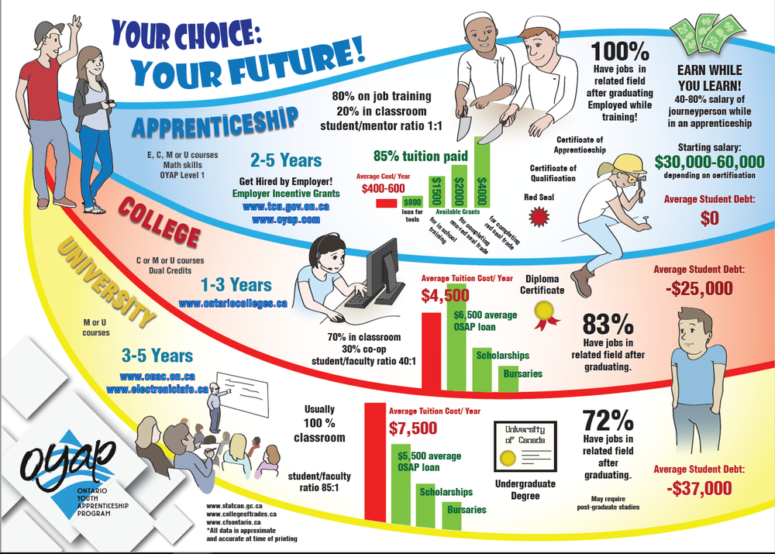

Slide 3
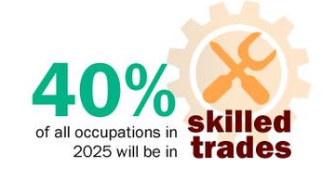
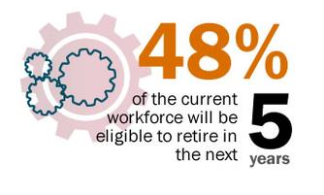
Why a Skilled Trade?
Ontario College of Trades 2017

Slide 4
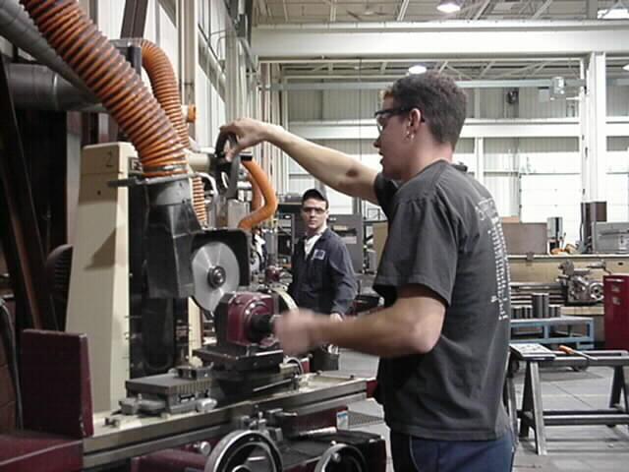
Why a Skilled Trade?
The average annual salary for a skilled trades person is 25% higher than the average Canadian wage ($50,000 vs. $40,000)
The average apprenticeship lasts between 2-5 years with 80% of the training done on the job while being PAID.
A certified journeyperson’s starting salary average is approximately $52,000
University graduate’s starting salary average is about $45,000
One in five new jobs in the province is expected to be in the skilled trades.

Slide 5
What is an Apprenticeship?
A way of learning a skilled trade from a professional tradesperson, also called a journeyperson
Qualifies people for employment in the skilled trades sectors
85 - 90% of training takes place in the workplace - learn the skills of a trade from an experienced journeyperson
Earn while you learn – apprentices are paid while gaining work experience and their wages increase with their level of skill
2-5 years in length

Slide 6
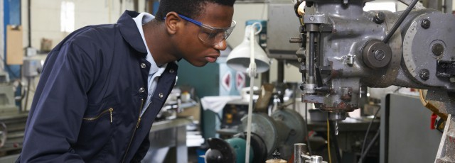
Four Sectors
Construction
Motive Power
Industrial
Service

Slide 7
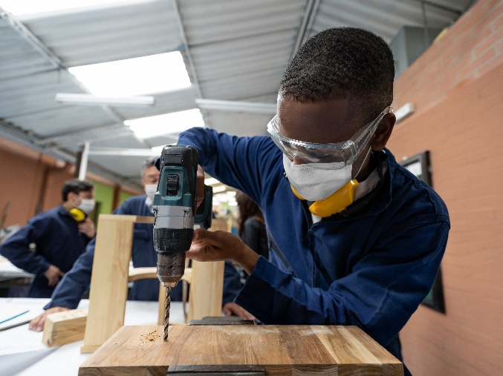
Construction
Examples of trades:
Brick and Stone Mason
Construction Craft Worker
Construction Millwright
Drywall Finisher/Plasterer
Electrician
General Carpenter
Heavy Equipment Operator
Ironworker
Painter
Plumber
Powerline Technican
Refrigeration/AC Mechanic
Roofer Steam Fitter
Sheet Metal Worker

Slide 8
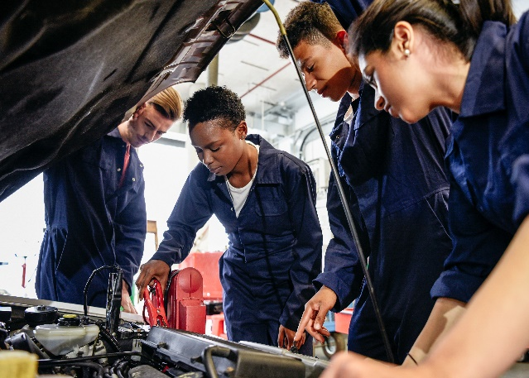
Motive Power
Examples of trades:
Auto Body Technician
Automotive Painter
Automotive Service Technician
Heavy Duty Equipment Technician
Marine Engine Repairer
Motorcycle Technician
Small Engine Mechanic
Tire, Wheel and Rim Mechanic
Transmission Technician
Truck/Coach Technician

Slide 9
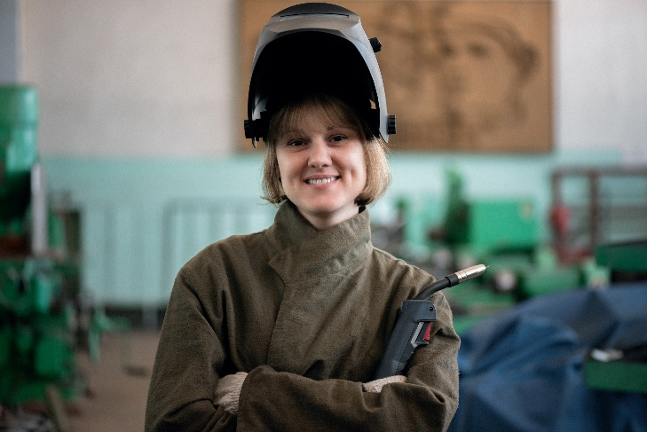
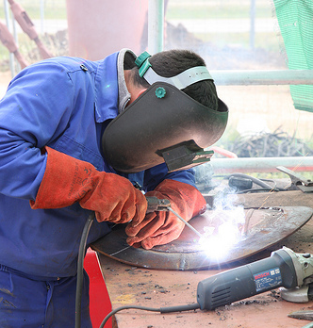
Industrial
Examples of trades:
Blacksmith
Cabinetmaker
CNC Programmer
Draftsperson
Facilities Maintenance Mechanic
General Machinist
Hydraulic Mechanic
Industrial Mechanic Millwright
Locksmith
Tool & Die Maker
Welder

Slide 10
Service
Examples of trades:
Agriculture Technician
Appliance Service Technician
Arborist
Baker
Child/Youth Worker
Child Development Practitioner
Cook
Electronic Service Technician
Hairstylist
Horse Groomer
Horticultural Technician
IT Technical Support Agent
Network Cabling Specialist
Pool & Hot Tub/Spa Technician

Slide 11
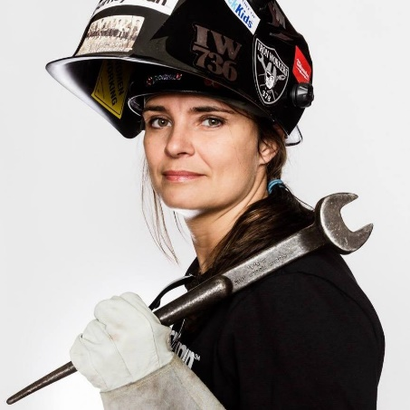
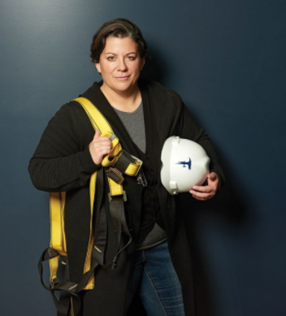
WOMEN in Skilled Trades
Women will account for two-thirds of the growth in the labour force over the next ten years.
Women are capable of doing every type of job in the skilled trades.
Women are an untapped talent pool when it comes to skilled positions.
Jamie MacMillian
Mandy Renehan
Kate Campbell

Slide 12
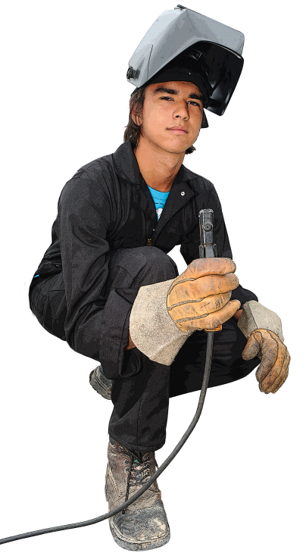
Who should consider a career in the Skilled Trades?
Hands-on learner
Like variety
Good problem-solver
Strong math & science
Creative
Learn by doing
Notes:
SOME COMMON CHARACTERISTICS
DOES YOUR SON / DAUGHTER POSSESS?
HAVE YOU EVER ENCOURAGED TO LOOK INTO A TECHNOLOGICAL CAREER?

Slide 13
What Employers look for in an Apprentice
Positive attitude
Passion for their
chosen industry,
and their company
Excellent
employability skills
Creativity, critical thinking and problem solving skills
Notes:
Soft skills are key to your success

Slide 14
Ways to prepare for an apprenticeship
Take courses in high school that match your career goals (tech classes)
Sign up for a SHSM program and/or dual credit if offered
Take Co-op in Grade 11 and/or 12 in a Skilled Trade (OYAP)
Apply to the Ontario Youth Apprenticeship program in Grade 11 (Regional Accelerated OYAP Program)

Slide 15
WHAT IS OYAP?
Ontario Youth Apprenticeship Program (OYAP) allows you to try a variety of apprenticeship-based careers in skilled trades, starting in Grade 11 or 12 through the COOP program available at your school.

Slide 16
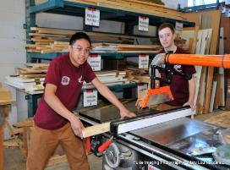
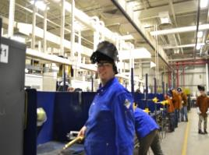
Three ways to OYAP in Secondary School
All students taking COOP in a Skilled Trade
Any student taking COOP who decides to REGISTER as an apprentice with the Ministry of Labour, Training and Skills Development (MLTSD)
All students taking part in a Regional Accelerated OYAP program

Slide 17
Regional Accelerated OYAP
In partnership with surrounding boards: DDSB, DCDSB, KPRDSB, PVNCDSB, TLDSB
Students receive Level 1 of apprenticeship training through the Training Delivery Agent (i.e. Durham College)
Students are in Co-op, but can also earn credits in apprenticeship training
Exit program in semester 2 of grade 12

Slide 18
Regional Accelerated Programs 2023
Cook/Chef – Durham College
Electrician – Durham College
General Carpentry – Fleming College
General Carpentry – Local 27 ** not dual credit
Hairstylist – Durham Hairstylist Academy (DHA)
Industrial Mechanic Millwright – Durham College
Motive Power (AST) – Durham College
Plumbing – Durham College
Welding – Durham College

Slide 19
Applying for Accelerated OYAP
You would need an average of 70% or higher at the College/University level in Math, English and Technology courses
Students with COOP and/or work experience in the chosen area of interest are given preference
Excellent attendance
Teacher references
Students need to complete all mandatory courses by Grade 12 - Semester 2
Complete and submit an OYAP application in the spring while in Grade 11 – with assistance from your COOP teacher/department
Course selection for 2022 2023 – choose a 4 credit COOP
You maybe asked to attend an interview with an industry expert
You get to complete a semester in your trade of choice in 2nd semester grade 12
You will earn 4 secondary school credits

Slide 20
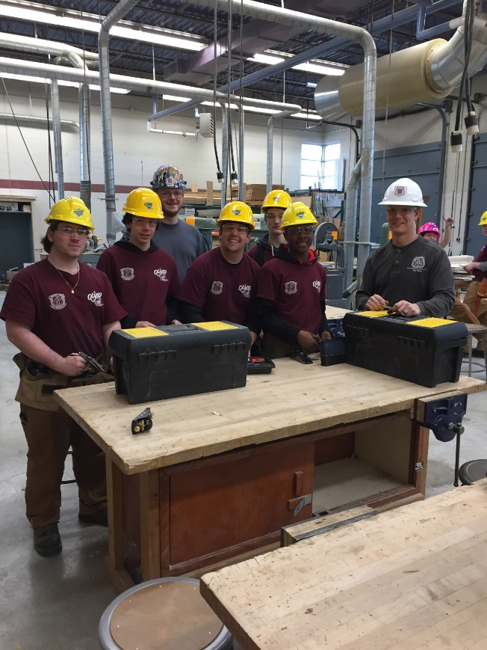
If you are Accepted into the Accelerated OYAP…..
Your COOP teacher will assist you to secure an OYAP employer
in their chosen field
A Registered Training Agreement will be signed
with the Ministry of Labour, Training and Skills Development
– needs to be submitted prior to attending the
training at the college or TDA!!
You will attend classes at the College
or Trade School during your Grade 12
second semester term – COOP teachers will provide ongoing
monitoring during this time

Slide 21
Resources
https://www.skilledtradesontario.ca/about-trades/trades-information/
https://www.jobtalks.org/
www.oyap.com
https://www.ontario.ca/page/labour-market
http://scwi.ca/resources/docs/research/2022/L1_TSP-EL/PathwayApprentice.pdf
Application Link:
https://www.ddsb.ca/OYAPRegional/
Questions - talk to your COOP department

